Slide 1
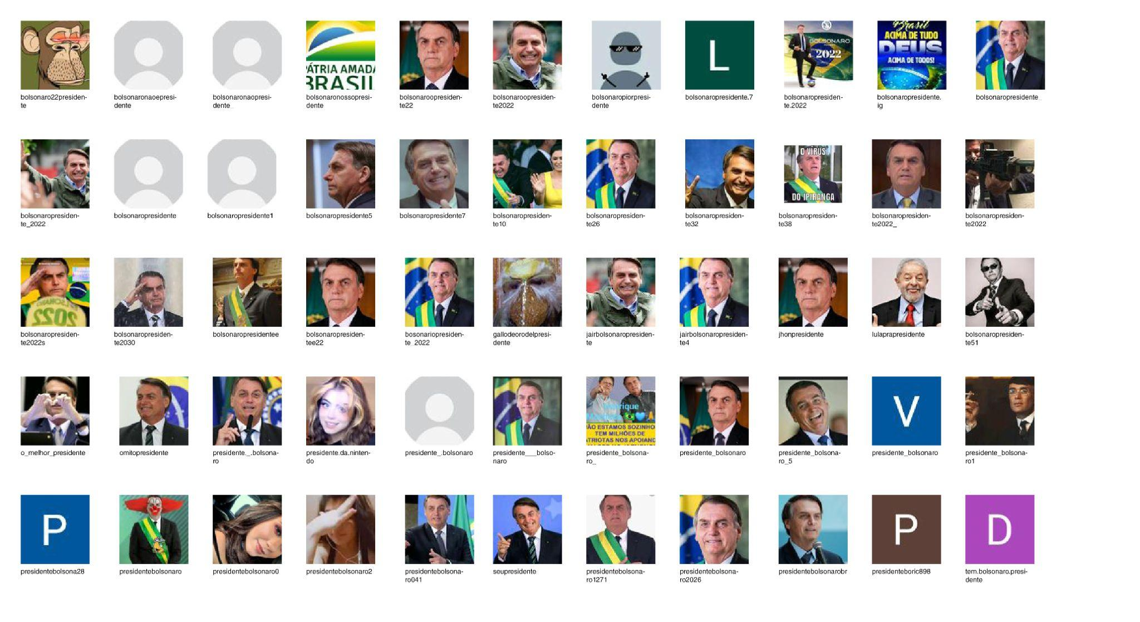
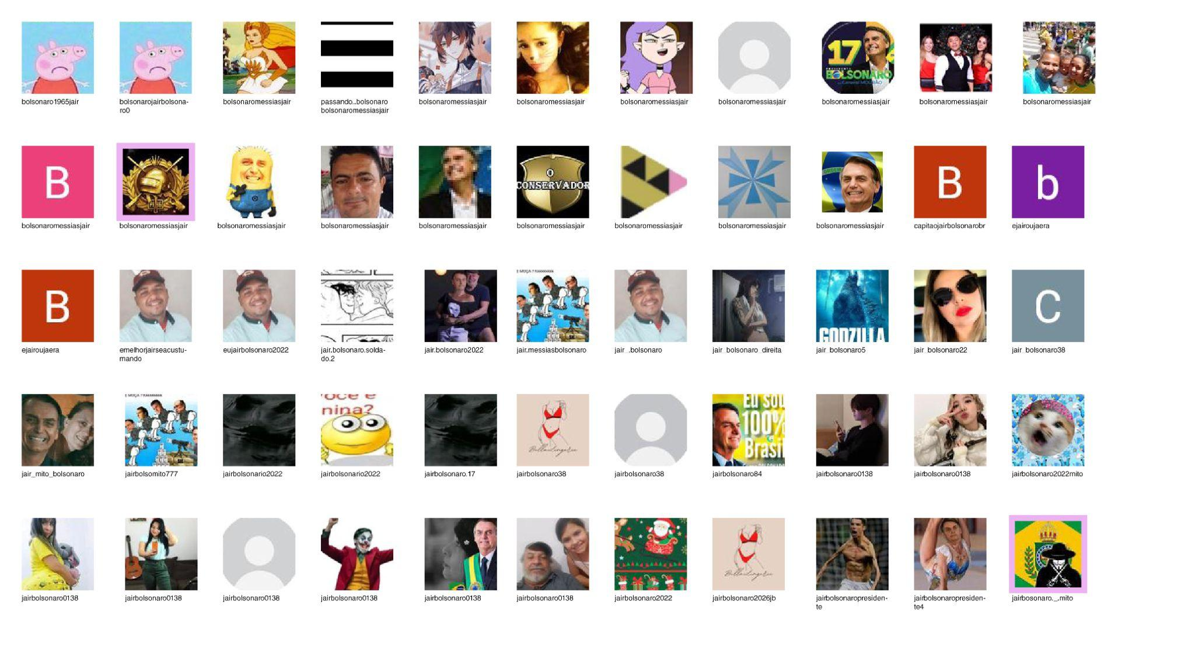
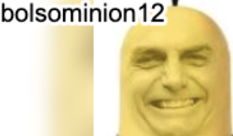

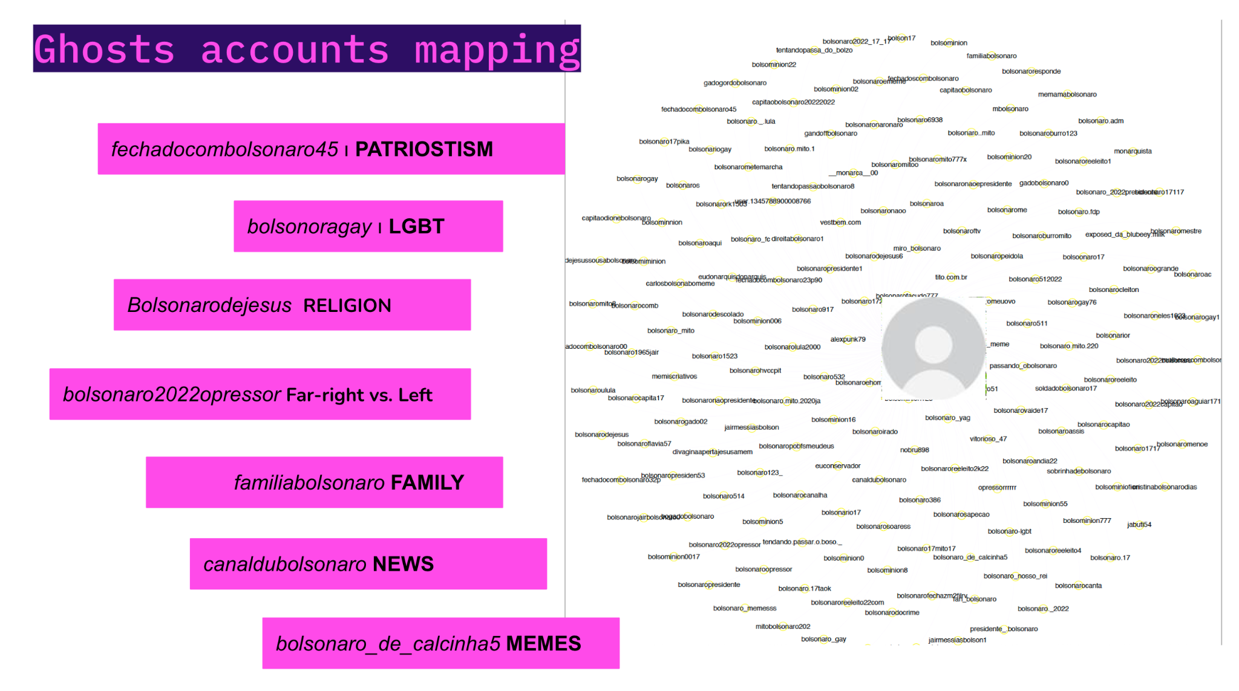
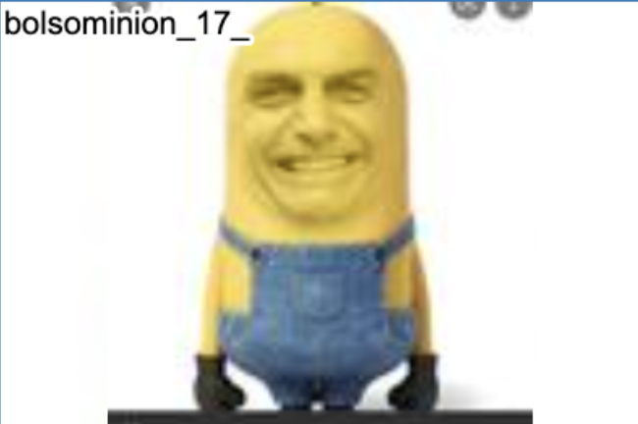
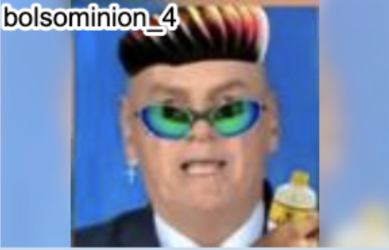
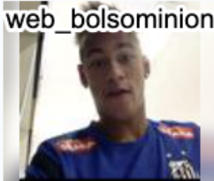
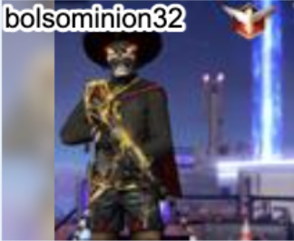
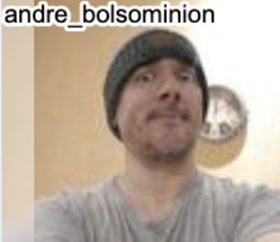

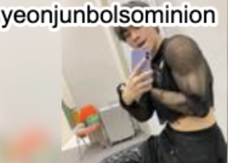
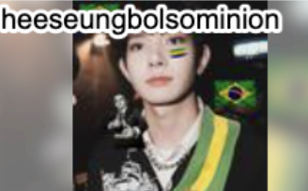
President
Jair
Bolsominions
ghost accounts
Political slogan
fechadocombolsonaro45
bolsonaro..mito
bolsonarocapitao
soldadobolsonaro17
memes
bolsonarosapecao
bolsonaro_de_calcinha5
bolsonarodescolado
bolsonaroirado
with president
bolsonaropresidente
bolsonariopresident53
presidente_.bolsonaro
lgbt
bolsonaro-lgbt
bolsonariogay
bolsonaro_gay
Human-like bolsobots
Human-like bolsobots
Human-like bolsobots
Notes:
TikTok pro-bolsobot accounts
Fazer um grid vertical:
President + jair messias bolsonaro ( com e sem images) → duas colunas (up with images, down no images)
Political campaign slogans found in Ghost Accounts → uma colunas (up ghost account image, down: usernames.
Bolsominions
Bolsominion images: https://drive.google.com/drive/folders/1xpMWBgjcjDBbbs3gCczmNspOV9r4eMTC
Tiktok data (including bolsominion list of names): https://docs.google.com/spreadsheets/d/12H4i4K5LMieM_70yR3S3dQJDeGneKDWu/edit#gid=1906762067

Slide 2
President
Jair
Bolsominions
ghost accounts
bolsominion.com.orgulho
bolsominion14
bolsominion006
bolsominion_com_amor
bolsominion_opressor
bolsominionsincero
bolsominion_forever
bolsominionvagabundo
bolsominion_kkkkkkkkkkjk
soldado_bolsominion
Political slogan
fechadocombolsonaro45
bolsonaro..mito
bolsonarocapitao
soldadobolsonaro17
memes
bolsonarosapecao
bolsonaro_de_calcinha5
bolsonarodescolado
bolsonaroirado
with president
bolsonaropresidente
bolsonariopresident53
presidente_.bolsonaro
lgbt
bolsonaro-lgbt
bolsonariogay
bolsonaro_gay
Human-like bolsobots
Human-like bolsobots
Human-like bolsobots
Notes:
TikTok pro-bolsobot accounts
Fazer um grid vertical:
President + jair messias bolsonaro ( com e sem images) → duas colunas (up with images, down no images)
Political campaign slogans found in Ghost Accounts → uma colunas (up ghost account image, down: usernames.
Bolsominions
Bolsominion images: https://drive.google.com/drive/folders/1xpMWBgjcjDBbbs3gCczmNspOV9r4eMTC
Tiktok data (including bolsominion list of names): https://docs.google.com/spreadsheets/d/12H4i4K5LMieM_70yR3S3dQJDeGneKDWu/edit#gid=1906762067

Slide 3
bolsominion username | type
bolsominion.com.orgulho | WITH PROUD
bolsominionanticomunista | ANTI-COMUNIST
bolsominion14 | ACCOUNT NAME REPETITION
bolsominion006
bolsominion22
bolsominion_com_amor | LOVE
bolsominion_opressor | OPRESSOR
bolsominionsoficial | OFFICIAL ACCOUNTS
bolsominionsincero | HONEST
bolsominion_forever | FOREVER
bolsominionvagabundo | TRAMP
bolsominioncareca2 | BOLD
bolsominion_kkkkkkkkkkjk | KKKKKK
soldado_bolsominion | SOLDIER

Slide 4
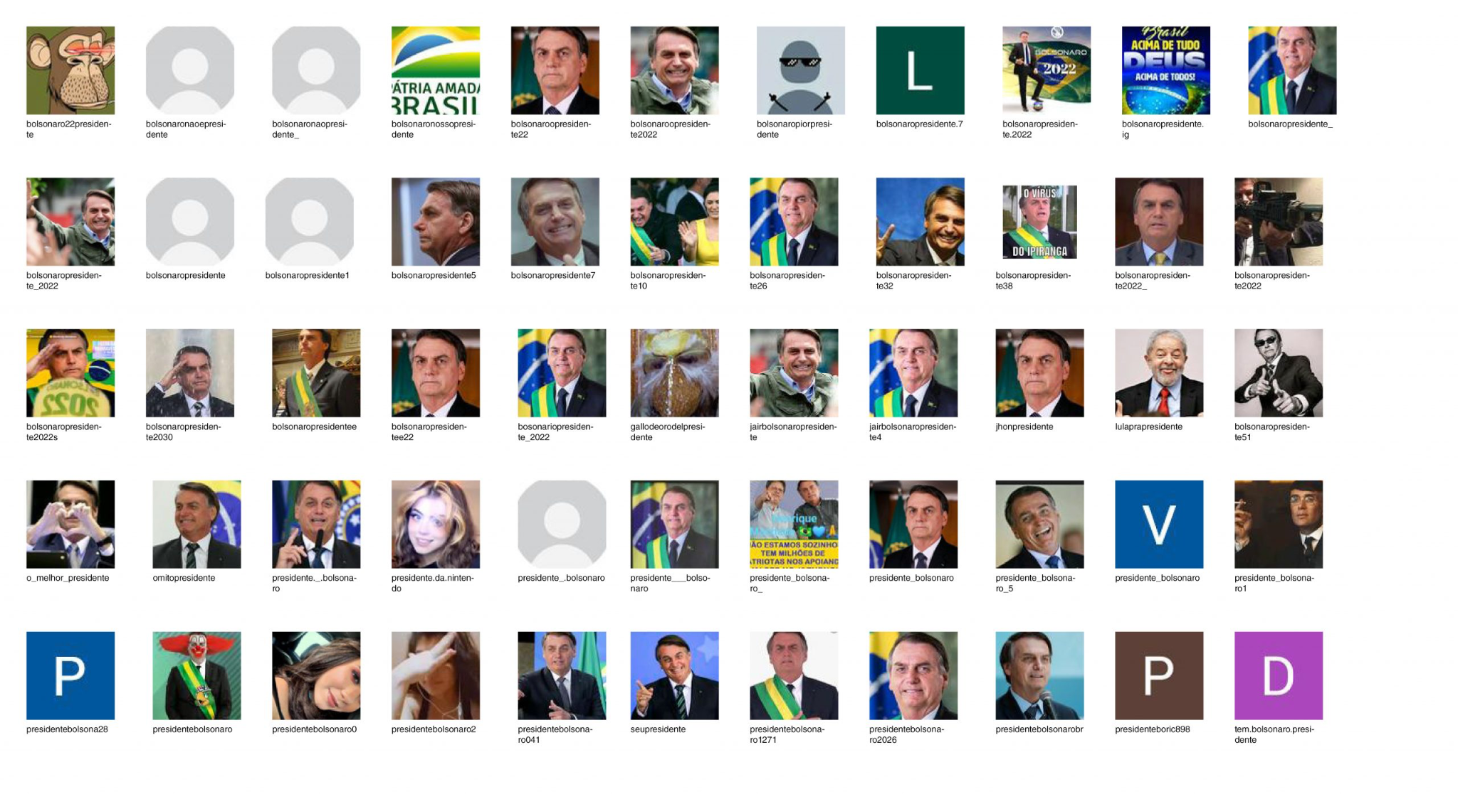
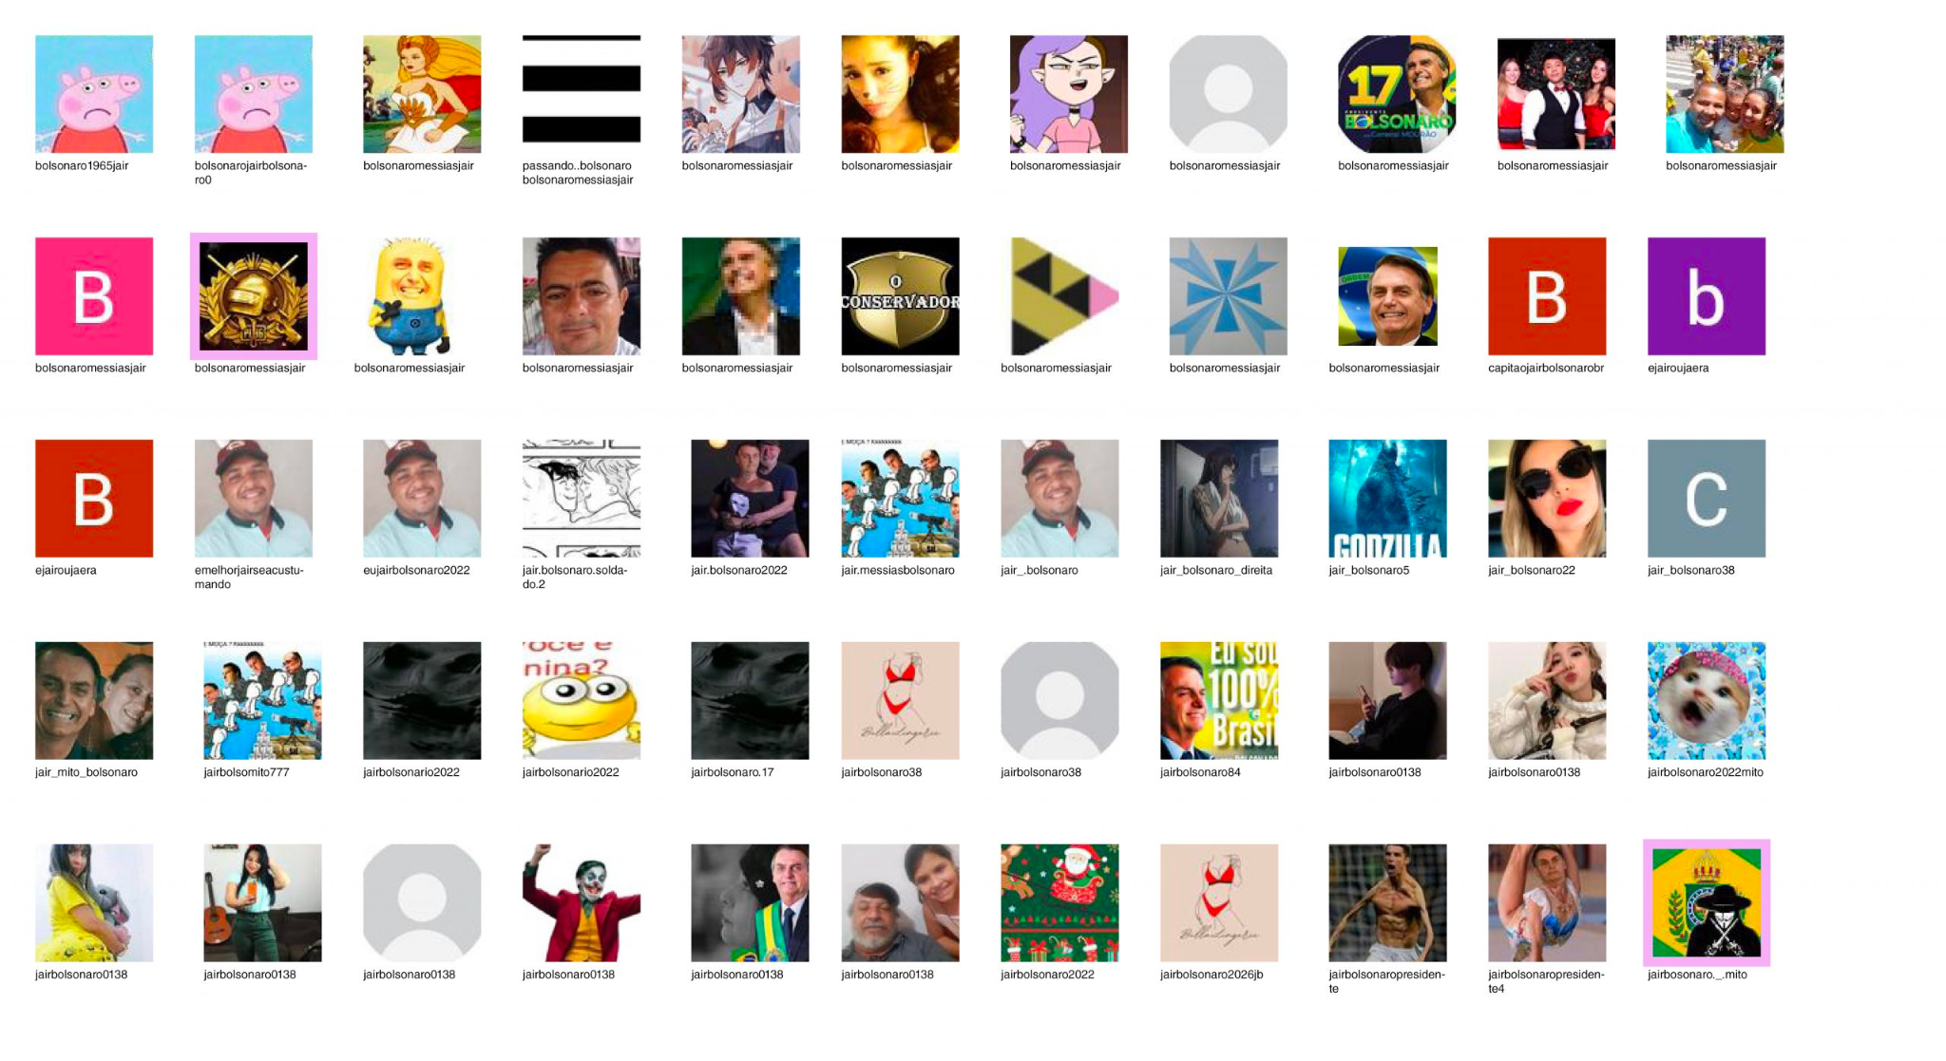

Slide 6
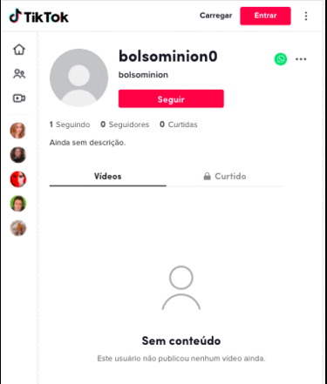
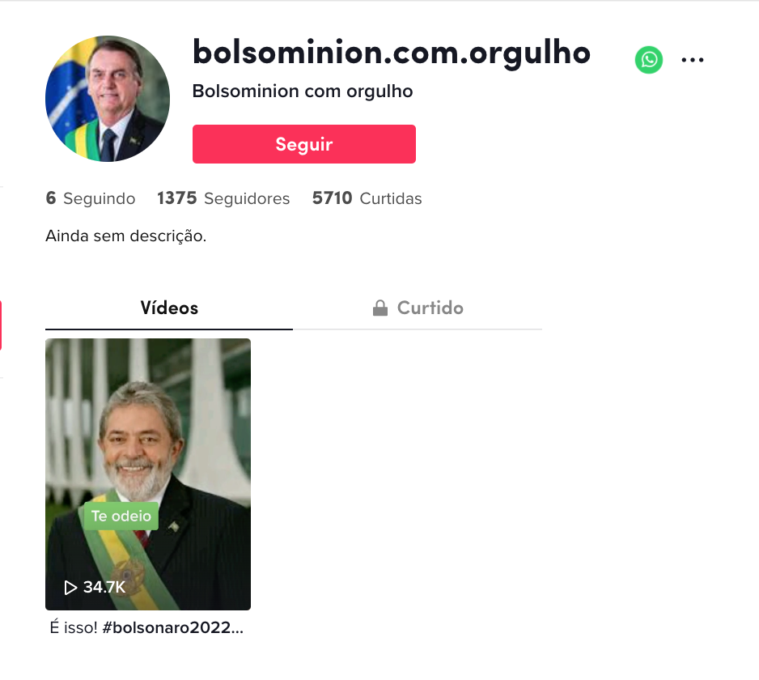
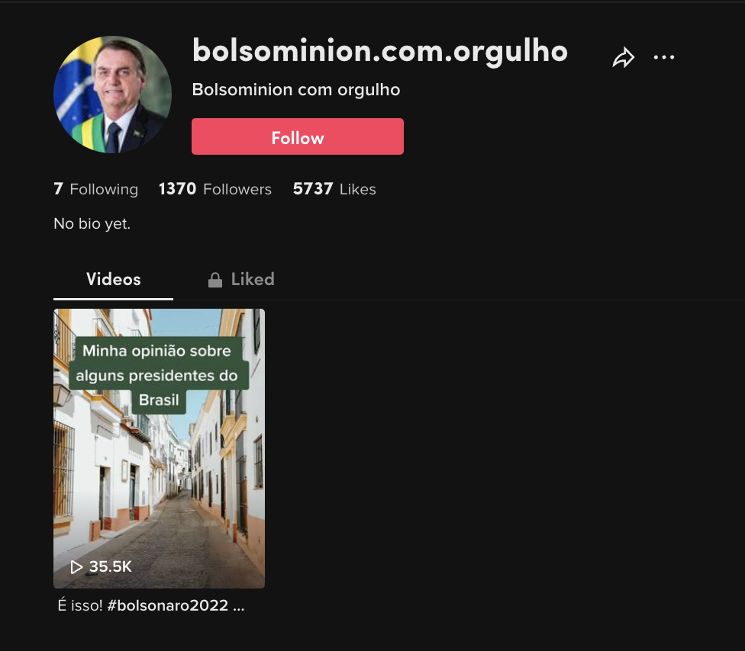
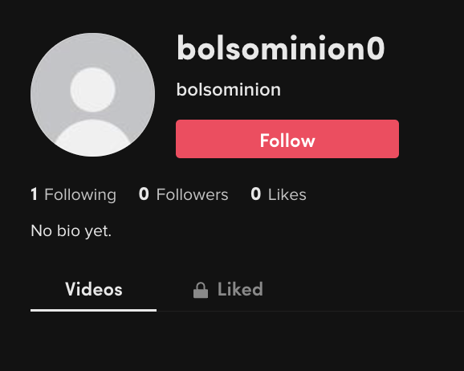
February 2022
May 2023

Slide 7
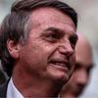

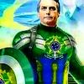
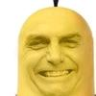
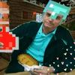
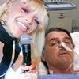
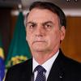
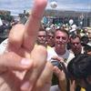
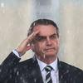
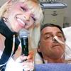
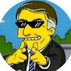
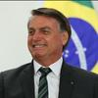
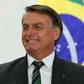
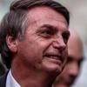
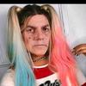
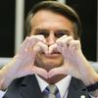
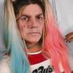
Bolsominions, February 2022

Slide 8
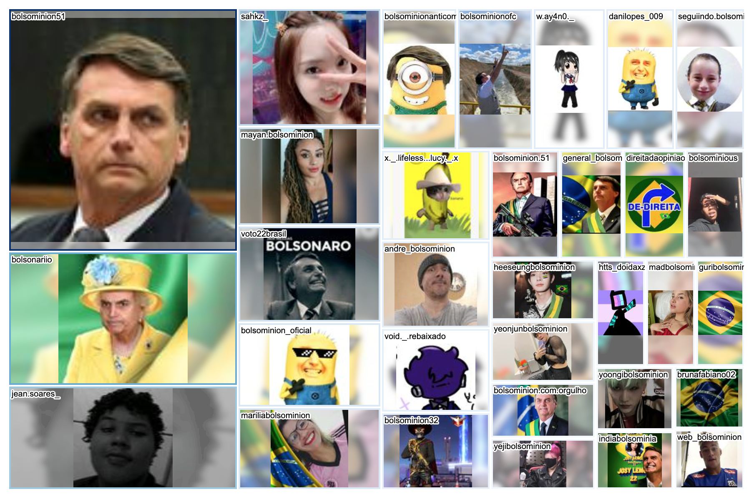
Bolsominions, February 2022

Slide 9
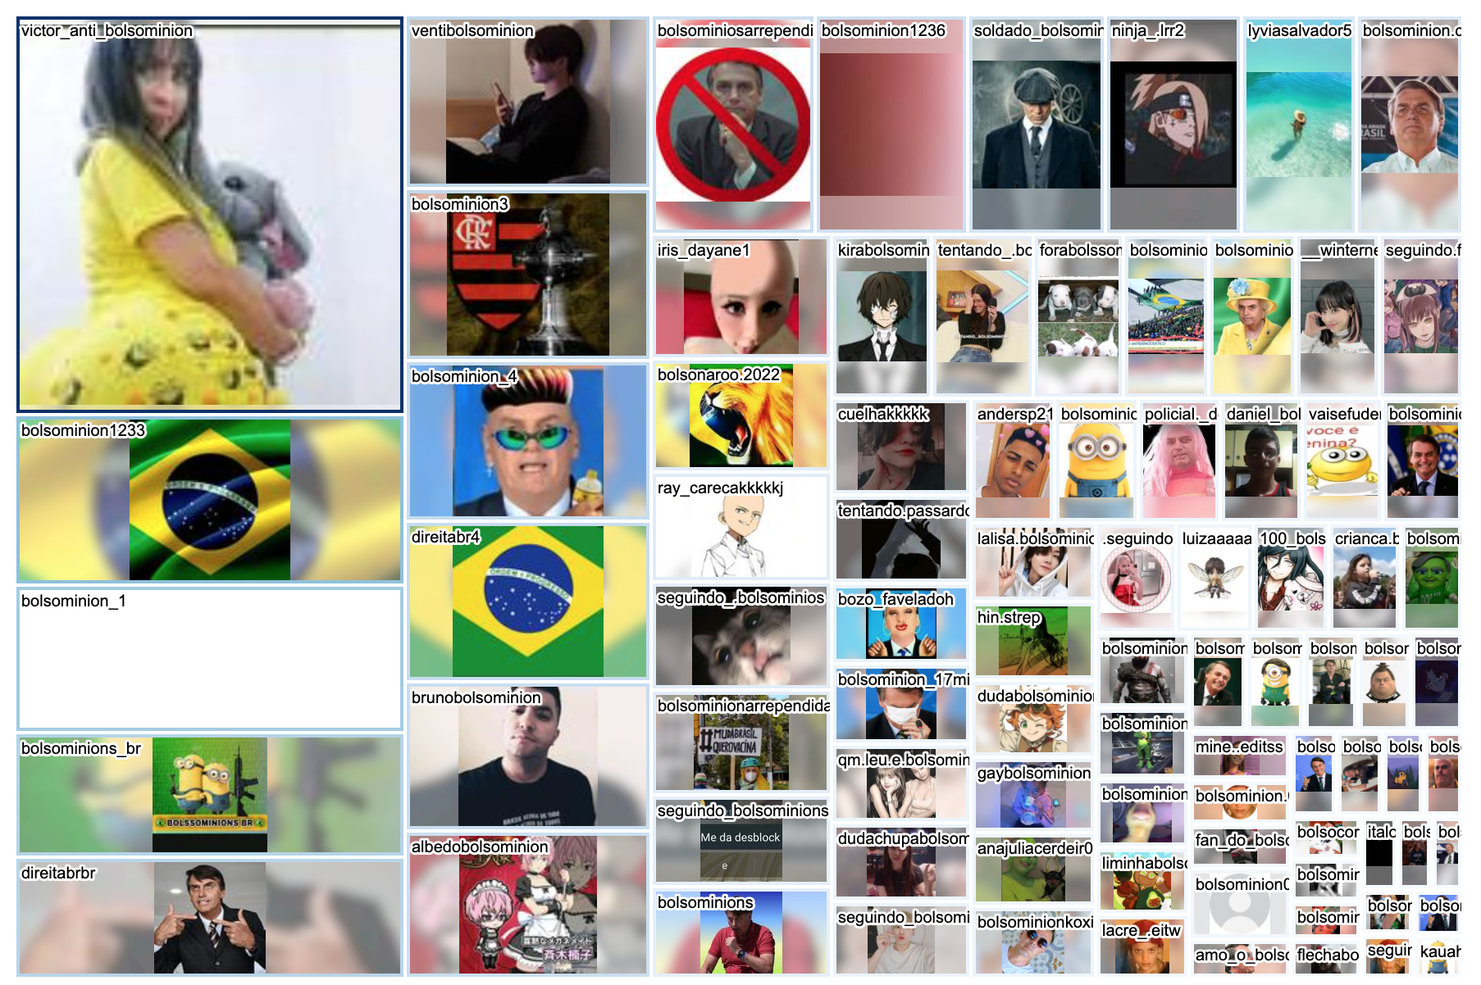
Bolsominions, February 2022

Slide 10
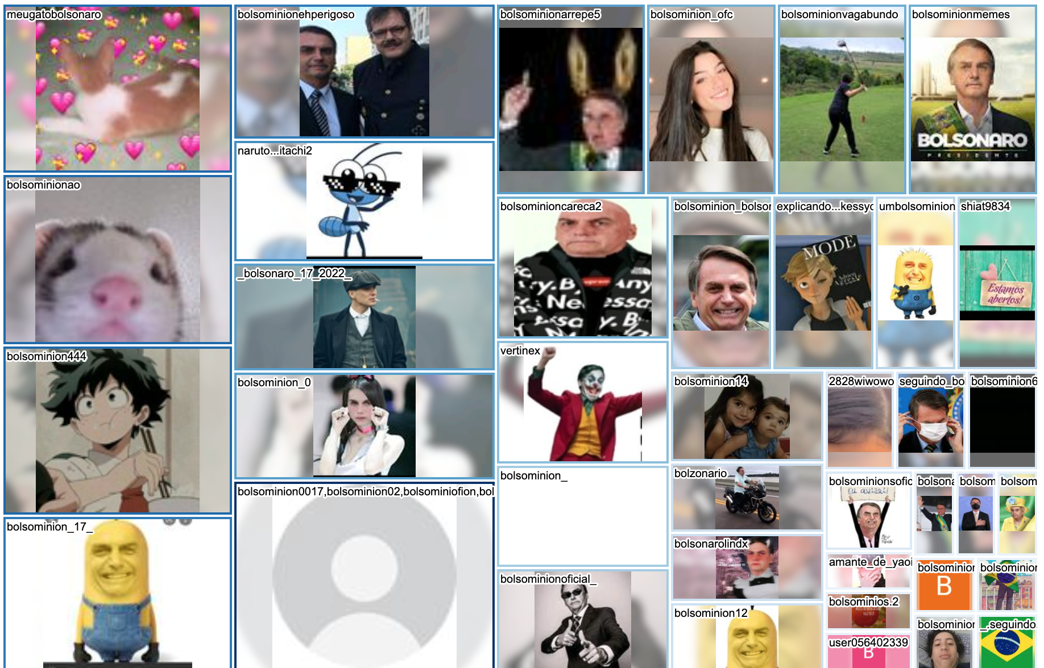
Bolsominions, February 2022

